Slide 1

ABFRL Brands-Store/Delivery Flow App Tagging
17th Oct 2023

Slide 2
Guidelines to Implement Tagging
Adobe Launch SDK should be installed before the custom tagging.
Copy and paste the keys of contextData as it is without changing the Camel Casing.
Context Data should be along with calling the Track State and Track Action functions.
<> this indicates dynamic value to be captured and passed.
Icid will be added to the next page’s URL where user lands after clicking any content of current page.
Testing will be performed by Implementation Team after ABFRL QA team will give the confirmation/sign off for the testing done by them.
UAT should be done first in staging and then in production post production UAT adobe’s codes are pushed to live.
For Customer ID, pass the value only when available else pass it as blank.

Slide 3
Super App Brands
Since Super App contains multiple cross-brands journey, therefore w.r.t to tracking the brand/product brand currently included( PFB the table with the expected value to be passed in the datalayer)
Brand/Product Brand | Datalayer Value
Van Huesen | vh
Peter England | pe
Allen Solly | as
Louis Phillipe | lp
Reebok | rbk
American Eagle | aoe
Forever 21 | f21
Simon Carter | sc

Slide 4
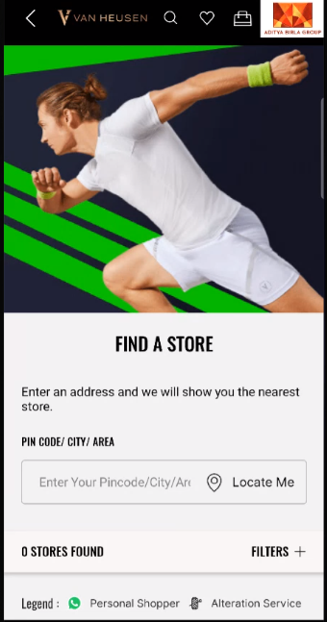
On load of Search store page

Slide 5
Page type | Tracking type | Launch variables | Expected values
Store page | On load | let contextData={ pageName: “search store page", channel: "<android/ios>|cms store locator", customerID : "<customerID>", // only pass when available brand: “<brand name>”, loginStatus : "<logged-in/guest>" , pageType : “<brand name> - store search page”, platform: "<android/ios>", userDetails: "<gender>|<age>", // pass only when user has logged in dob: "<date of birth>" // pass only when user is logged in // pass only when user has logged in }; ACPCore.trackState(“store search page",contextData); | loginStatus may have the values:- logged-in guest

Slide 6
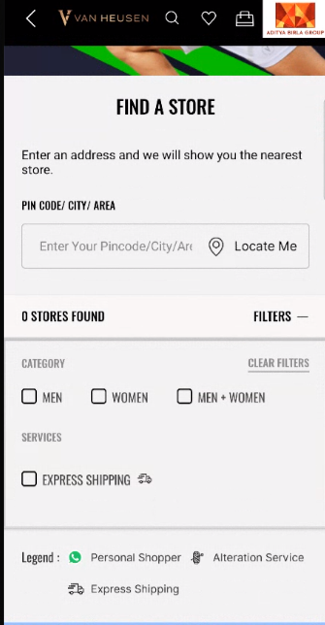
On click of Filters

Slide 7
Page type | Tracking type | Launch variables | Expected values
Store page | On Click | let contextData={ linkName:“<cta name>", channel:"<android/ios>|cms store locator", linkPageName: “store search page", customerID : "<customerID>", // only pass when available brand: “<brand name>”, loginStatus : "<logged-in/guest>" , platform: "<android/ios>", userDetails: "<gender>|<age>", // pass only when user is logged in dob: "<date of birth>" // pass only when user is logged in }; ACPCore.trackAction(“<cta name>", contextData); | loginStatus may have the values:- logged-in guest

Slide 8
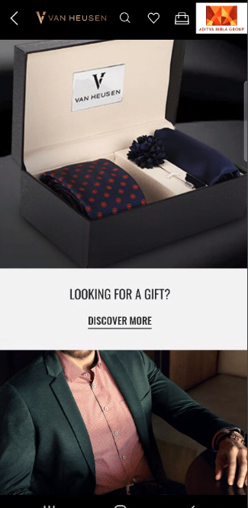
On Banner/Widget Click

Slide 9

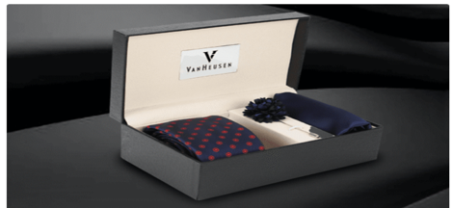
click type | Tracking type | Launch variables | Expected values
Any Banner click or Widget click | banner | let contextData={ linkName : “<banner click/widget click>", channel: "<android/ios>|cms store locator", customerID : "<customerID>", // only pass when available linkPageName: “store search page", loginStatus : "<logged-in/guest>" , brand: “<brand name>”, icid : "<page type>-<brand name>|<banner name>|<widget name>|<cta name>|<banner/widget position>|<banner/widget type>“, //if a banner or widget is clicked platform: "<android/ios>", userDetails: "<gender>|<age>", // pass only when user is logged in dob: "<date of birth>" // pass only when user is logged in }; ACPCore.trackAction(“banner click", contextData); Expected values : In brand, the expected values are vh as lp pe reebok aoe f21 sc | loginStatus may have the values:- logged-in guest icid will be passed when a banner or widget is clicked. icid should always be passed in the given format only. Pass na if any value is missing. Example values for Banner Type:- hero banner category banner slim banner text banner, etc. Example for Widget Type :- shop top seller recommended by you shop by category, etc. Example value :- home page-sc|born to flex|NA|banner click/mens/shop now/widget click|1|hero banner home page-sc|NA|looking for a gift|widget click|1|looking for a gift

Slide 10
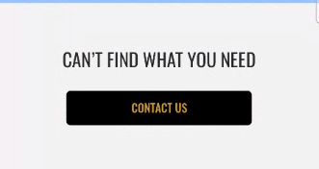
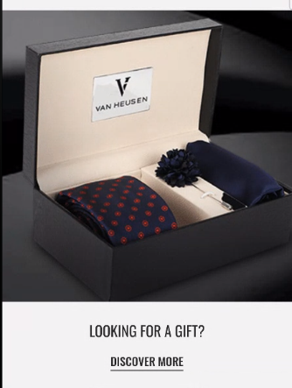
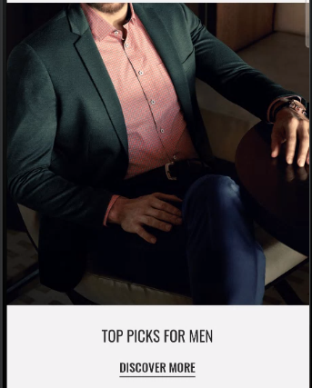
On all CTA clicks

Slide 11
click type | Tracking type | Launch variables | Expected values
CTA clicks | button | let contextData={ linkName:“<cta name>", channel:"<android/ios>|cms store locator", linkPageName: “store search page", customerID : "<customerID>", // only pass when available brand: “<brand name>”, loginStatus : "<logged-in/guest>" , platform: "<android/ios>", userDetails: "<gender>|<age>", // pass only when user is logged in dob: "<date of birth>" // pass only when user is logged in }; ACPCore.trackAction(“<cta name>", contextData); | loginStatus may have the values:- logged-in guest

Slide 12
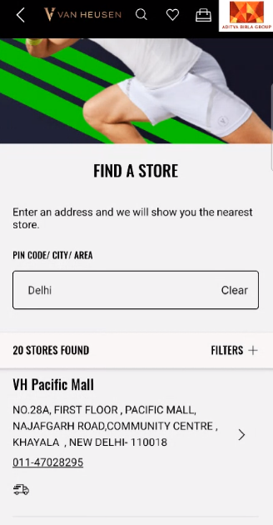
On address click

Slide 13
click type | Tracking type | Launch variables | Expected values
Address click | button | let contextData={ linkName:“address click", channel:"<android/ios>|cms store locator ", linkPageName: “store search page", customerID : "<customerID>", // only pass when available storeSearchType: “<pincode/locate me/area name>”, //if user clicks on locate me or searches through pincode or area name storeDetails: “<storeCode>|<storeName>|<storePincode>”, brand: “<brand name>”, loginStatus : "<logged-in/guest>" , platform: "<android/ios>", userDetails: "<gender>|<age>", // pass only when user is logged in dob: "<date of birth>" // pass only when user is logged in }; ACPCore.trackAction(“<locate me/address click>", contextData); | loginStatus may have the values:- logged-in guest

Slide 14
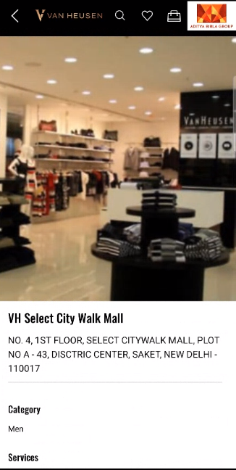
Store Page Load

Slide 15
Page type | Tracking type | Launch variables | Expected values
Store Details page | On load | let contextData={ pageName: “store details page", channel: "<android/ios>|cms store locator", customerID : "<customerID>", // only pass when available brand: “<brand name>”, storeDetails: “<storeCode>|<storeName>|<storePincode>”, loginStatus : "<logged-in/guest>" , pageType : “<brand name> - store details page”, platform: "<android/ios>", userDetails: "<gender>|<age>", // pass only when user has logged in dob: "<date of birth>" // pass only when user is logged in // pass only when user has logged in }; ACPCore.trackState(“store details page", contextData); | loginStatus may have the values:- logged-in guest

Slide 16
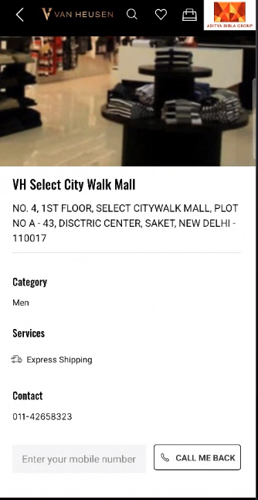
On click of call back icon

Slide 17
Click type | Tracking type | Launch variables | Expected values
Call me back | button | let contextData={ linkName: “call me back", channel:"<android/ios>|cms store locator", linkPageName: “store details page", brand: “<brand name>”, customerID : "<customerID>", // only pass when available loginStatus : "<logged-in/guest>" , platform: "<android/ios>", userDetails: "<gender>|<age>", // pass only when user is logged in dob: "<date of birth>" // pass only when user is logged in }; ACPCore.trackAction(“call me back", contextData); | loginStatus may have the values:- logged-in guest

Slide 18
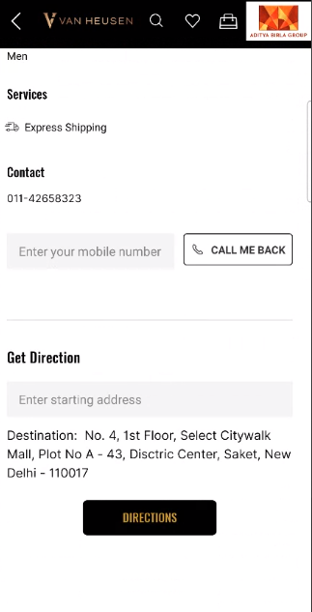
On click of shop directions

Slide 19
Click type | Tracking type | Launch variables | Expected values
Direction to shop | button | let contextData={ linkName: “direction", channel:"<android/ios>|cms store locator", brand: “<brand name>”, linkPageName: “store details page", customerID : "<customerID>", // only pass when available loginStatus : "<logged-in/guest>" , platform: "<android/ios>", userDetails: "<gender>|<age>", // pass only when user is logged in dob: "<date of birth>" // pass only when user is logged in }; ACPCore.trackAction(“direction", contextData); | loginStatus may have the values:- logged-in guest

Slide 20
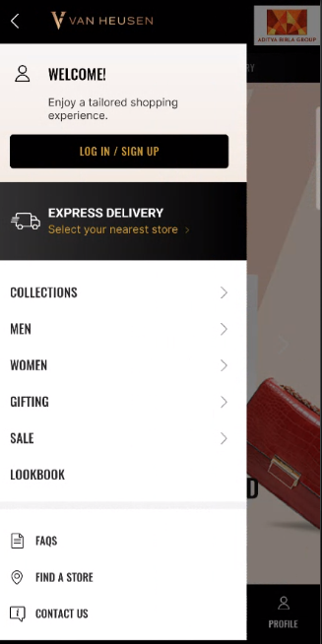
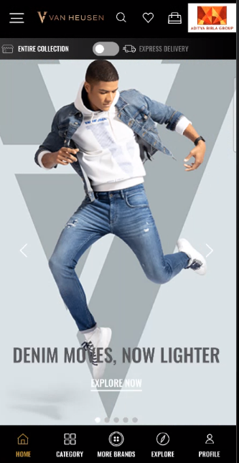
On click of Express Delivery button

Slide 21
Click type | Tracking type | Launch variables | Expected values
CTA click | button | let contextData={ linkName: “express delivery", channel: "<android/ios>|<page name from which menu is clicked without the word “page”>", // eg : android|home, android|category, &&events: “event81” // pass only when express delivery button is clicked brand: “<brand name>”, linkPageName: “<page name>", //the name of the page from where menu was clicked, eg : home page, plp, pdp customerID : "<customerID>", // only pass when available loginStatus : "<logged-in/guest>" , platform: "<android/ios>", userDetails: "<gender>|<age>", // pass only when user is logged in dob: "<date of birth>" // pass only when user is logged in }; ACPCore.trackAction(“express delivery", contextData); | loginStatus may have the values:- logged-in guest

Slide 22
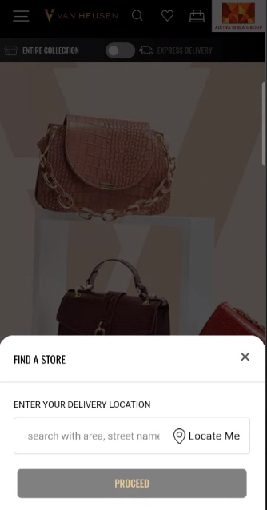
On Load of Express Delivery Pop-up

Slide 23
Page type | Tracking type | Launch variables | Expected values
Express delivery Pop-up | On load | let contextData={ pageName: “find a store", channel: "<android/ios>|<parent page name without the word “page”>", // eg : android|home, ios|category, etc , brand: “<brand name>”, parentPage: “<parent page name>“, //page name where this modal popsup. customerID : "<customerID>", // only pass when available loginStatus : "<logged-in/guest>" , pageType : “<brand name> - <parent page>”, platform: "<android/ios>", userDetails: "<gender>|<age>", // pass only when user has logged in dob: "<date of birth>" // pass only when user is logged in // pass only when user has logged in }; ACPCore.trackState(“express delivery", contextData); | loginStatus may have the values:- logged-in guest

Slide 24
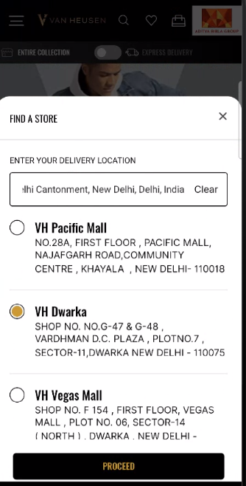
On Load of search results

Slide 25
Page type | Tracking type | Launch variables | Expected values
Search result Pop-up | On load | Let contectData={ pageName: “store search result page", channel: "<android/ios>|<parent page name without the word “page”>", // eg : abdroid|home, ios|category, etc &&events: “event82=<total number of stores found>”//pass no. of stores found storeSearchType: “<pincode/locate me/area name>”, //if user clicks on locate me or searches through pincode or area name brand: “<brand name>”, parentPage: “<parent page name>“, //page name where this modal popsup. customerID : "<customerID>", // only pass when available loginStatus : "<logged-in/guest>" , pageType : “<brand name> - <parent page>”, platform: "<android/ios>", userDetails: "<gender>|<age>", // pass only when user has logged in dob: "<date of birth>" // pass only when user is logged in // pass only when user has logged in }; ACPCore.trackState(“store search result page", contextData); | loginStatus may have the values:- logged-in Guest storeSearchType will have following value: pincode locate me area name

Slide 26
CTA click

Slide 27
Click type | Tracking type | Launch variables | Expected values
CTA click | button | let contextData={ linkName: “<cta name>", channel: "<android/ios>|<parent page name without the word “page”>", // eg : android|home, ios|category, etc , brand: “<brand name>”, storeSearchType: “<pincode/locate me/area name>”, //if user clicks on locate me or searches through pincode or area name storeDetails: “<storeCode>|<storeName>|<storePincode>”, parentPage: “<parent page name>“, //page name where this modal popsup. linkPageName: “store search result page", customerID : "<customerID>", // only pass when available loginStatus : "<logged-in/guest>" , platform: "<android/ios>", userDetails: "<gender>|<age>", // pass only when user is logged in dob: "<date of birth>" // pass only when user is logged in }; ACPCore.trackAction(“<cta name>", contextData); | loginStatus may have the values:- logged-in guest storeSearchType will have following value: pincode locate me area name

Slide 28
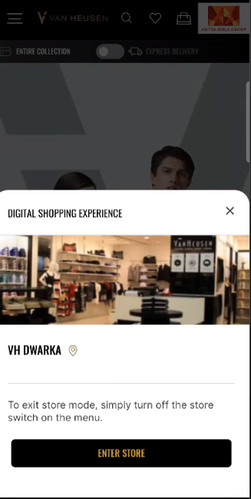
On Load of Shop details Pop-up

Slide 29
Page type | Tracking type | Launch variables | Expected values
Shop Details Pop-up | On load | let contextData={ pageName: “shop details page", channel: "<android/ios>|<parent page name without the word “page”>", // eg : android|home, ios|category, etc , brand: “<brand name>”, storeDetails: “<storeCode>|<storeName>|<storePincode>”, parentPage: “<parent page name>“, //page name where this modal popsup. customerID : "<customerID>", // only pass when available loginStatus : "<logged-in/guest>" , pageType : “<brand name> - <parent page>”, platform: "<android/ios>", userDetails: "<gender>|<age>", // pass only when user has logged in dob: "<date of birth>" // pass only when user is logged in // pass only when user has logged in }; ACPCore.trackState(“shop details page", contextData); | loginStatus may have the values:- logged-in guest

Slide 30
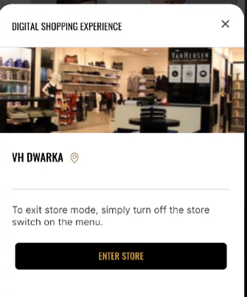
CTA click

Slide 31
Click type | Tracking type | Launch variables | Expected values
CTA clicks | button | let contextData={ linkName: “<cta name>", channel: "<android/ios>|<parent page name without the word “page”>", // eg : android|home, ios|category, etc , brand: “<brand name>”, storeDetails: “<storeCode>|<storeName>|<storePincode>”, parentPage: “<parent page name>“, //page name where this modal popsup. linkPageName: “shop details page", customerID : "<customerID>", // only pass when available loginStatus : "<logged-in/guest>" , platform: "<android/ios>", userDetails: "<gender>|<age>", // pass only when user is logged in dob: "<date of birth>" // pass only when user is logged in }; ACPCore.trackAction(“<cta name>", contextData); | loginStatus may have the values:- logged-in guest

Slide 32
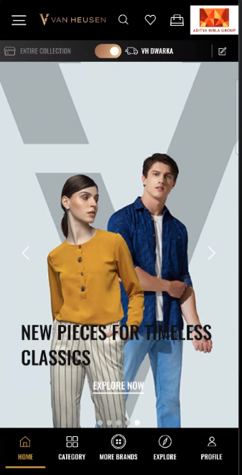
On click of Store switch

Slide 33
Click type | Tracking type | Launch variables | Expected values
Store toggle on/off | toggle | let contextData={ linkName: “<enable express delivery/disable express delivery>",//when user enables or disables express delivery channel: "<android/ios>|<page name without the word “page”>", // eg : android|home, ios|category, etc , brand: “<brand name>”, linkPageName: “<page name>",eg. home page, catergory page, etc customerID : "<customerID>", // only pass when available loginStatus : "<logged-in/guest>" , platform: "<android/ios>", userDetails: "<gender>|<age>", // pass only when user is logged in dob: "<date of birth>" // pass only when user is logged in }; ACPCore.trackAction(“<linkName>", contextData); | loginStatus may have the values:- logged-in guest

Slide 34
On click of Edit Store

Slide 35
Click type | Tracking type | Launch variables | Expected values
Edit store | icon | let contextData={ linkName: “edit store”, channel: "<android/ios>|<page name without the word “page”>", // eg : android|home, ios|category, etc , brand: “<brand name>”, linkPageName: “<page name>",eg. home page, catergory page, etc customerID : "<customerID>", // only pass when available loginStatus : "<logged-in/guest>" , platform: "<android/ios>", userDetails: "<gender>|<age>", // pass only when user is logged in dob: "<date of birth>" // pass only when user is logged in }; ACPCore.trackAction(“edit store", contextData); | loginStatus may have the values:- logged-in guest

